Slide 1



Slide 2


GCSE Statistics Results
You have all sat and achieved your first GCSE qualification this summer. It’s already in the bag!
Qualifications | Students | Average Grade
Statistics | 197 | 5
Polish | 1 | 9
Portugese | 1 | 9
Russian | 1 | 9
Spanish | 2 | 7
The grade you achieved in your Statistics exam should be your benchmark and foundation for GCSE Maths this year.
You have already achieved a GCSE in a maths subject. If we achieve a grade 5 on average in Maths in Year 11, the majority of you will be accepted on your Sixth Form and college places.
You already know what it takes to gain a GCSE without another year of practice, hard work and building better habits. Think of what you can achieve at the end of Year 11.

Slide 3

How will we ‘Lock In’?
Everyone in Year 11 participates to create the right environment – no exceptions
Our school values
                Honesty
                Ambition
                Teamwork
                Employability Standards

Slide 4
Honesty
We are respectfully open about our successes and areas for growth.
Accepting criticism about performance and behaviour can be difficult to hear. Positively responding by thinking about the verbal and body language we use will help us to have a conversation which will improve our behaviour and performance, as well as preventing extra conflict.
Think before we speak and act. Every action has a reaction which is either positive or negative. Having control will allow to get more positive reactions than negative ones. If you are willing to accept the positive consequences, you have to take accept the negative and learn from it.
Show everyone at Wilsthorpe respect. Every person deserves to come to this school without fear, upset or disrespect. Show tolerance of others beliefs and opinions.
Set yourself small targets throughout the year. We will help you with this.
You are responsible for your organisation. Not your parent/guardian. Not your tutor/teachers. You! Ask these people for support but you are ultimately responsible!
Having a positive response
Behaviour
Respect
Target setting
Organisation
What does this look like?

Slide 5
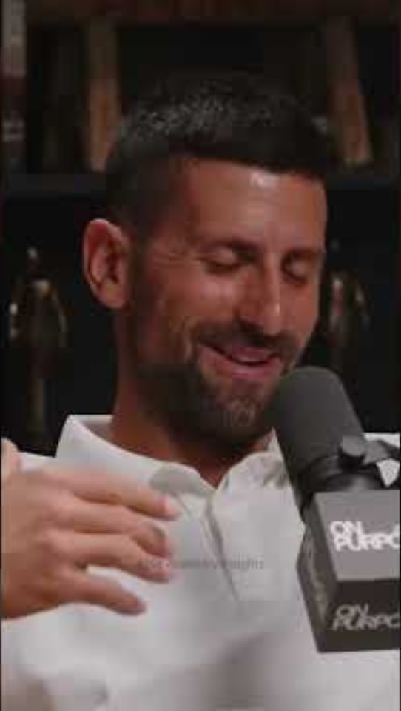
Honesty
We are respectfully open about our successes and areas for growth.

Slide 6
Ambition
We maximise our potential through striving for excellence.
95% + Attendance – You have to actually be in the lesson to grab the opportunity
Being on time means you have good start, no conflict and that we don’t waste time.
Being Ready to learn and having equipment/resources means no time wasted.
Habits of attention – 3, 2, 1 STAR
Homework is completed on time and to best of your ability.
Prepare for trials and revise little and often from now! Your first trial (mock) is at the end of this term.
Intervention/Extra-curricular = take advantage of extra opportunities
Work for appreciations. Small victories and rewards along the way will help to motivate you.
An excellent or focussed ‘Attitude for Learning’ in EVERY lesson, including form time.
We cannot waste a single opportunity in Year 11 to work towards your own success.
What does this look like?

Slide 7
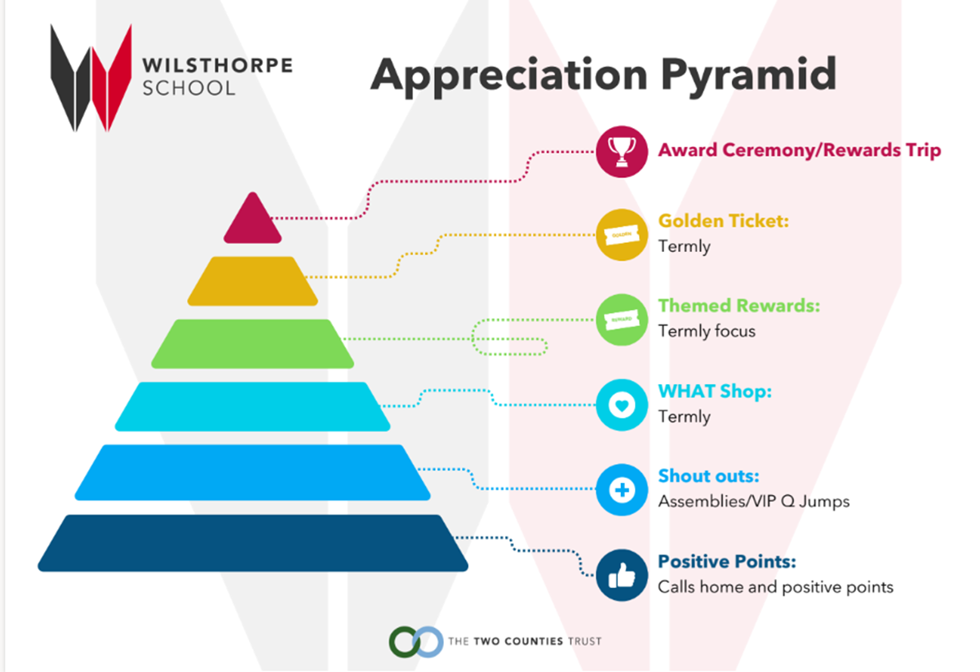
Ambition
Next week is a WHAT Sticker Week. Each member of staff will have a sheet of stickers to give out to students for their outstanding efforts and attitude.
You will be able to exchange your WHAT Stickers at the WHAT shop on Friday lunchtime. You can save them up over the year to be able to buy more expensive items at the shop with them.
You can also save them up to get money off your Prom ticket. More info on this to come!

Slide 8
Ambition
3-2-1 Star – Why do we need this in Year 11?
This will be used in all of your lessons this academic year.
The principles of this strategy are key for you to ‘Lock In’ over the next year to secure success both academically and personally.
Research shows that attention is not a fixed personal trait, but a trainable skill and a set of automatic habits shaped by our environment, repetition, and social cues.
Focus is socially infectious. Studies on group environments reveal that distracted peers or “visual saboteurs” (slouching, heads on desk, disengagement) rapidly reduce the concentration of surrounding individuals like a domino effect. If we all work on our attention, we create an environment we can all be successful in.
Ambition: 3-2-1 Star
•The S is for “Stop, Sit up, Silence” – Stop what you are doing. Look interested and stay engaged. Be silent and adopt attentive body language.
•The T is for “Track the speaker” - Show speakers that you are listening to what is being said by following with your eyes.
•The A is for “Answer questions in full sentences” – One-word answers are rarely asked for, so ensure you respond with an appropriate amount of detail. Use grammatically correct full sentences responses and ambitious vocabulary.
•The R is for “Respect for all”- You must show respect for others in both words and actions (all the time).

Slide 9
Teamwork
Belonging & Community – Form Group, Year Group, Whole School. Work together to achieve individual success by creating a positive environment in school.
Form time is now more important than ever. You will get lots of important information about subjects, intervention, exams, and key events. You punctuality and participation doesn’t just impact you, it impacts everyone in your form group.
Kindness is fundamental to life. Coming to school and feeling safe, secure and happy is a right we all have. As role models for the rest of the school you action and demonstrate this daily. In corridors, in the diner, in lessons, in assemblies…wherever you are your behaviour and actions has an impact on someone else. Choose kindness.
We give 100% effort, displaying kindness and humility for the benefit of all.
Belonging
Community
Form time
Kindness
Supporting each other
What does this look like?

Slide 10
Year 11 Calendar
Monday 14th September 2026 | Year 11 Launch Event | Wednesday 3rd February 2027 – Friday 12th February 2027 | Year 11 Trial Exams 2
W/C Monday 21st September 2026 | Year 11 Music Performances | Friday 12th February 2027 – Monday 15th February 2027 | Iceland Trip
Thursday 1st October 2026 | Sixth Form Open Evening | W/C Monday 8th March 2027 | Data Collection & Trackers
Thursday 8th October 2026 | Year 11 Drama Performances | Tuesday 22nd March 2027 | Year 11 Intervention Evening
Wednesday 14th October 2026 | Year 11 TTCT Careers Fair | Wednesday 14th April 2027 | Year 11 Drama Performance Day
Thursday 15th October 2026 – Friday 23rd October 2026 | Year 11 Trial Exams 1 | Monday 10th May 2027 – Friday 18th June 2027 | GCSE Exams
W/C Monday 16th November 2026 | Data Collection and Tracker 1 | TBC | Year 11 Leavers Day
Tuesday 24th November 2026 | Year 11 Parents’ Evening | Friday 25th June 2027 (TBC) | Prom

Slide 11
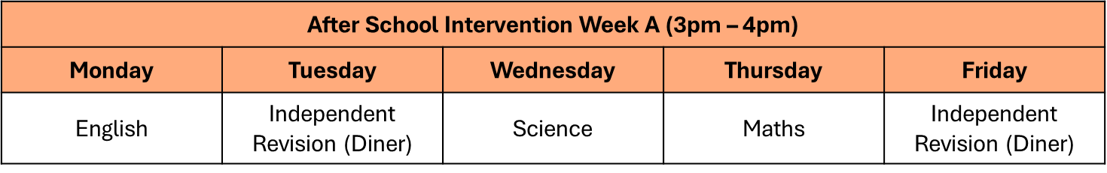
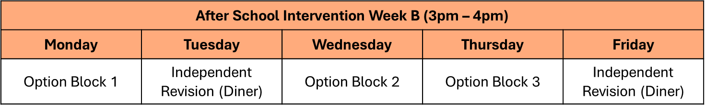
Intervention
What does form time intervention look like?
Compulsory.
Subject areas will select different groups of students for targeted intervention to help build confidence, fill in gaps of knowledge and build resilience.
Important you are on time to form so you can make the most out of the 30 minute intervention session.
These groups will change over the year, and session will become more and more frequent. Will begin after Oct Half Term.
- Past year groups it has shown to improve students success by an average of one grade on in that subject. That could be the difference between a 3 and a 4. A place at 6th From/college or having to do an alternative.
After-school Intervention
Over this term we will be introducing after-school intervention which everyone in Year 11 is invited to.
Some people the invitation will be compulsory due to their performance/effort/attainment in lessons and this will be communicated with parents/families.
We will be launching the first after-school intervention window from w/c Monday 14th September 2026.
You will have access to laptop for independent revision. Use this time to complete revision and homework.
No phones during this time. They must stay in the pouches.
You can sit with your friends, and work together, but this must be done sensibly and quietly.

Slide 12
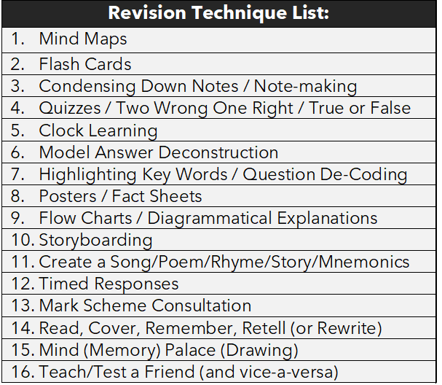

Form time support: Revision
Everybody learns and remembers in a different way - it is about finding the method(s) that work for your child.

Slide 13
Of the 16 methods the following are particularly useful for GCSE Students:
Method 1 - Mind Maps
Method 2 - Flash Cards
Method 3 - Condensing Down Notes
Method 4 - Two Wrong, One Right
Method 5 - Clock Learning
Method 6 - Model Answer Deconstruction
Method 7 - Highlighting
Method 12 - Timed Responses
Method 13 - Mark Scheme Consultation

Slide 14
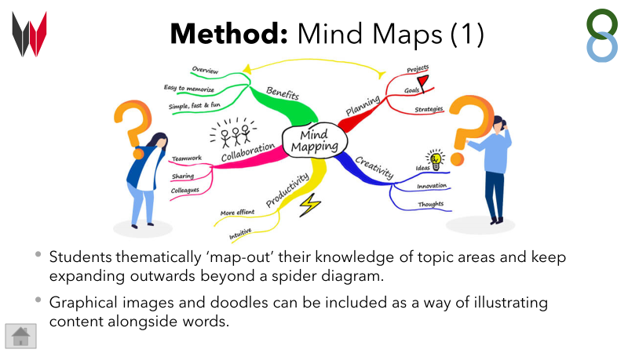

Slide 15
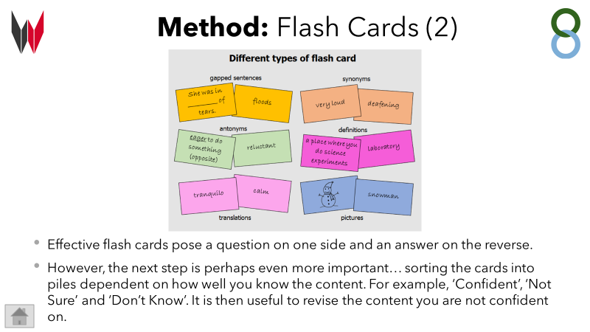

Slide 16
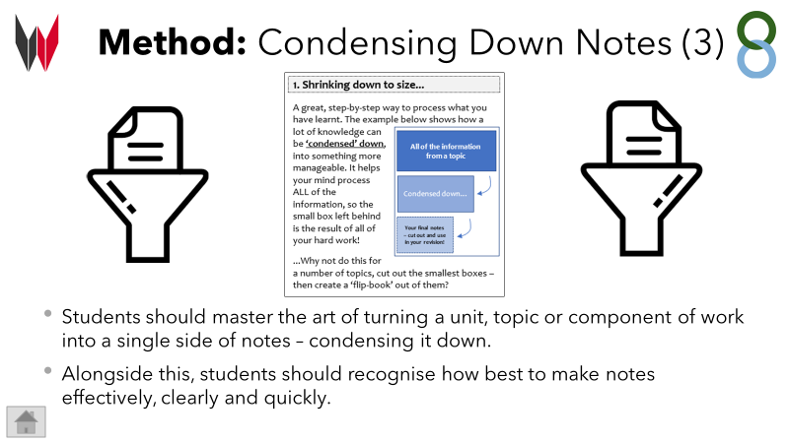

Slide 17
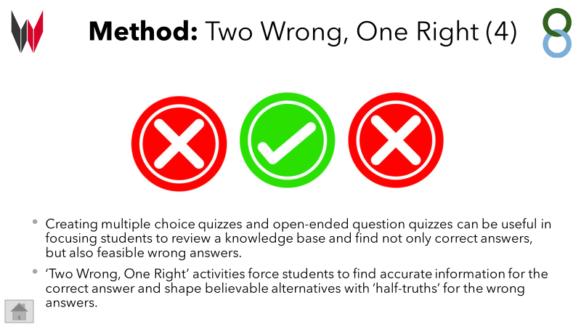

Slide 18
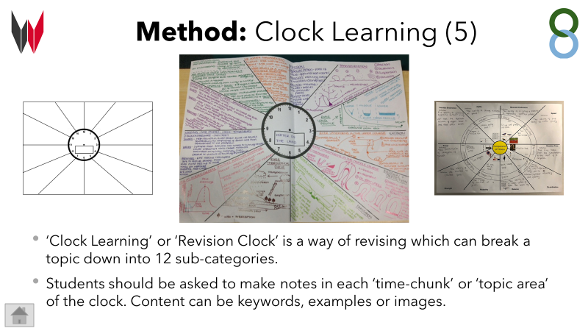

Slide 19
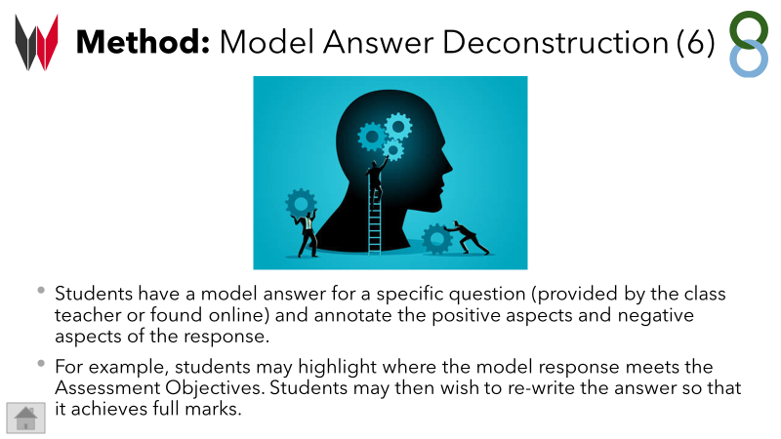

Slide 20
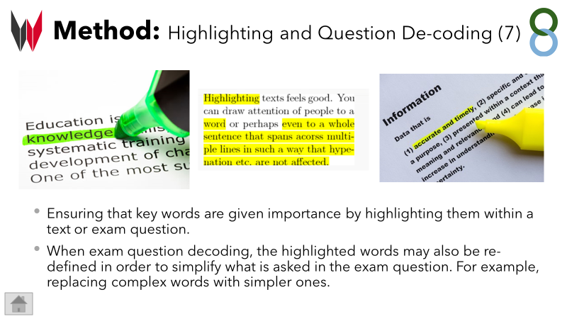

Slide 21
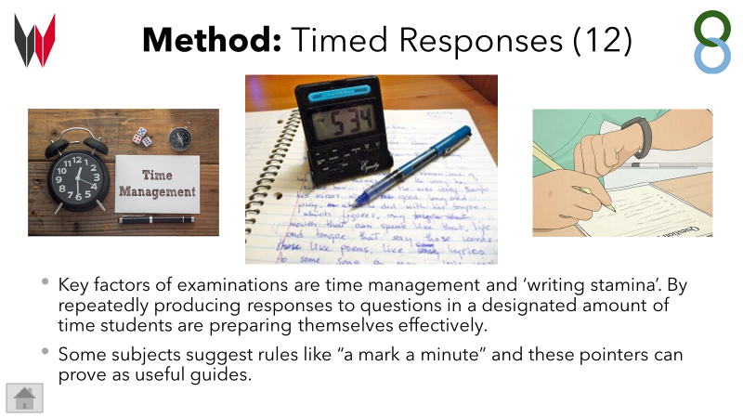

Slide 22
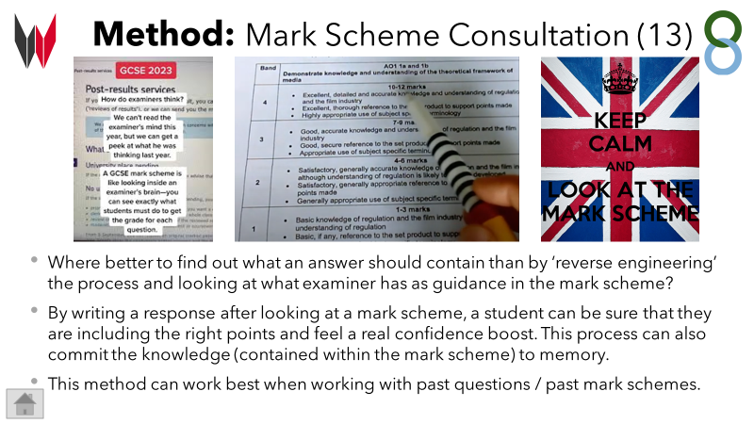

Slide 23


KS4 100% Booklets
Tomorrow, we will launch the 100% Booklets for Year11. These booklets are designed to enable core knowledge and terminology to be memorable when revisited over time.

Slide 24
KS4 100% Booklets
KS4 100% Booklets should be brought to school everyday and will be referred to in lessons and can be used to support revision for assessments. Subject teachers will provide subject specific advice on how best to use these for their courses.
You can annotate them and add extra notes in to support your learning.

Slide 25
Homework at KS4
The Key Stage 4 homework system balances academic rigour and the embedding of routine study habits. This system will support the transition both from Key Stage 3 to Key Stage 4 and from Key Stage 4 to Key Stage 5.

Slide 26


Year 10 and 11:
Homework in English, Maths and Science will be set and submitted every week.
Option subjects will determine the frequency with which they set homework and students will be informed of this.
All teachers within a subject will adhere to the same frequency of setting homework.
You are also expected to complete a minimum of 15 minutes reading every night using your reading book. This should be logged on the reading log in the student handbook. This will be checked by your tutor.
Staff will record all of your homework tasks and
dates for submission under the ‘Assignments’ tab
on Microsoft Teams.

Slide 27
Other Key Year 10 and 11 Homework Information:
Students will be awarded 3 positive points for the successful completion of homework.
A negative point and a same-day correction will be issued for the non-completion of homework.
To support students, the library will be open from 3pm – 4pm every day for students to complete their work in a quiet study space. Computers are available for use in the library if needed. Students can also seek help from their subject teachers during break time, lunch time or after school.

Slide 28
Maths

Slide 29

You don’t need to be good at maths to be able to help your child with their maths revision!
There are lots of things you can do to support them.
Provide an appropriate work space
Help with designing a revision plan
Reward if revision is taking place
Don’t forget to talk about the Maths!

Slide 30
SPARX MATHS
Will form part of the weekly homework for Year 11 in Maths.
Set and due every Tuesday (at 4pm and 8am respectively) with 100% completion required.
Retrieval topics from the previous term.
Link with regular Do Now tasks completed in lessons.
Levels will be automatically adapted based on speed of work and ability.
Should be completed independently without the use of AI

Slide 31
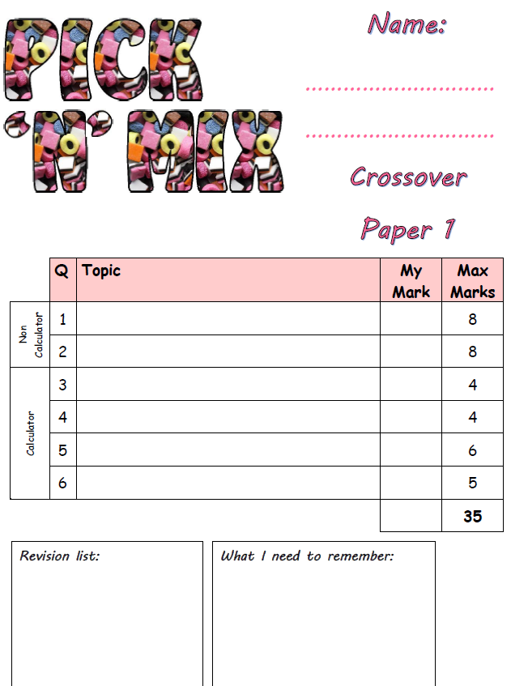
EXAM PRACTICE
Will form the second part of the weekly homework for Year 11 in Maths.
Set and due every Tuesday and completion with full working out is required.
Levelled based on ability.
A variety of topics to aid retrieval
and application of knowledge.
To ensure all students get regular
exam practice and support with
exam technique.

Slide 32
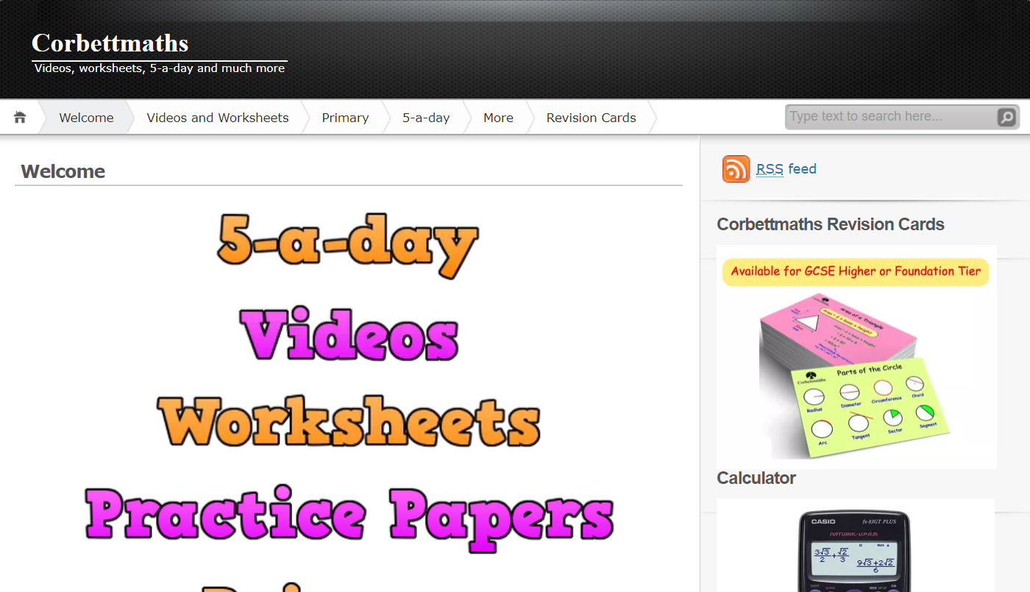
Corbett Maths – can be used to practice specific topics
There are support videos, practice questions and exam questions on every topic.

Slide 33
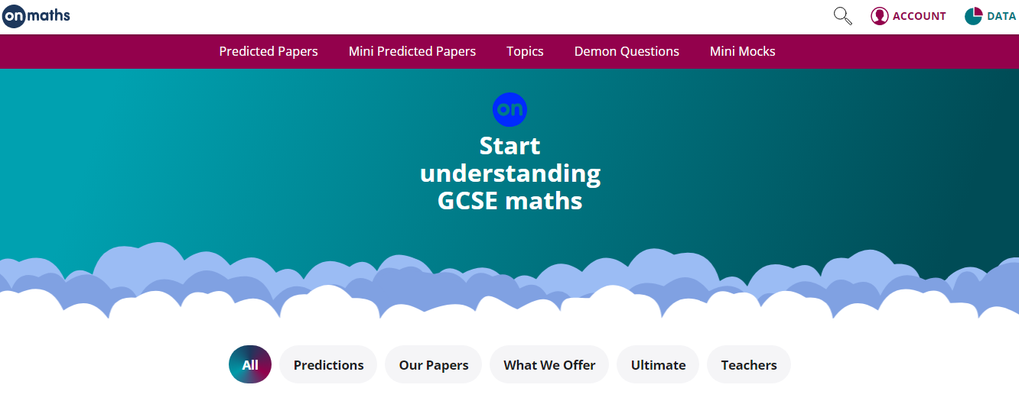
OnMaths – can be used to practice specific topics (no need to login or create an account).
There are mini mocks (assorted topics), demon questions (the hardest questions from each paper) or predicted papers as we approach exams.

Slide 34

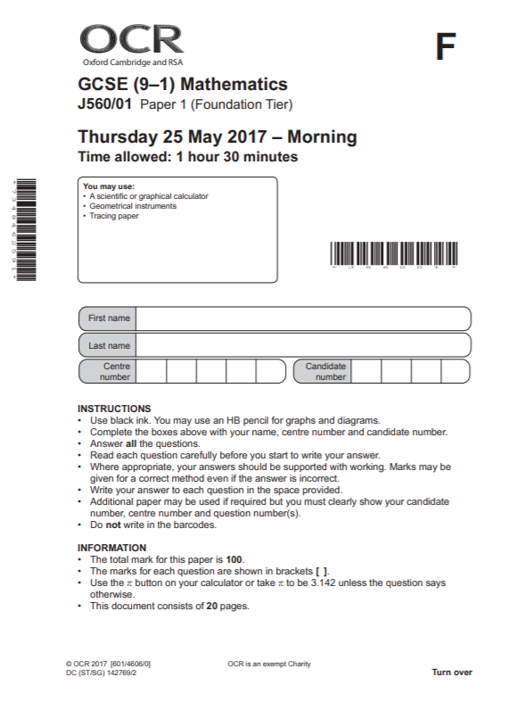
Past Exam Papers - the most important thing to work on and to use are past exam papers.
They inform students where they are (using official grade boundaries).
They inform students which topics they need to revise.
Students need to know the average grade boundaries for their target grade and be working towards achieving that score.
These will be used for the trial exams
in Year 10 and key questions will be
used throughout the year.

Slide 35

PinPoint Learning - targeted questions on students’ weakest topics.
Students will upload their scores per question from full papers they complete and this will tell them their 5 weakest topics per paper to work on.
They will receive a booklet of questions (which they can print off) with questions of increasing difficulty on these topics.

Slide 36



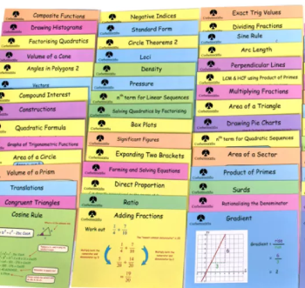




Revision cards/revision books and workbooks – teachers will be able to give more information on these to their classes.

Slide 37
English

Slide 38

English Language: ways to revise
Practice makes perfect!
Writing is 50% of the Language GCSE.
Get your child to choose an image off the internet to describe or give them a topic to write persuasively about.
Time your child for 45 minutes.
Read through what they have done. Is it interesting? Have they structured their writing? Have they used ambitious vocabulary?
There is a lot of knowledge in the 100% booklet they can use to help them.
Trial: Paper 1 Full Paper

Slide 39




Literature
Students need to know quotations for all their texts. We recommend they learn our Top 10 quotations as a minimum. You can test them on these – they are all in the 100% booklet.
We have videos on all of our Top 10 Quotations made by Wilsthorpe teachers.
Use flashcards and mind maps to revise characters, plots, themes, big ideas and writer's methods.
Trial: Paper 1 – Romeo and Juliet, Frankenstein

Slide 40
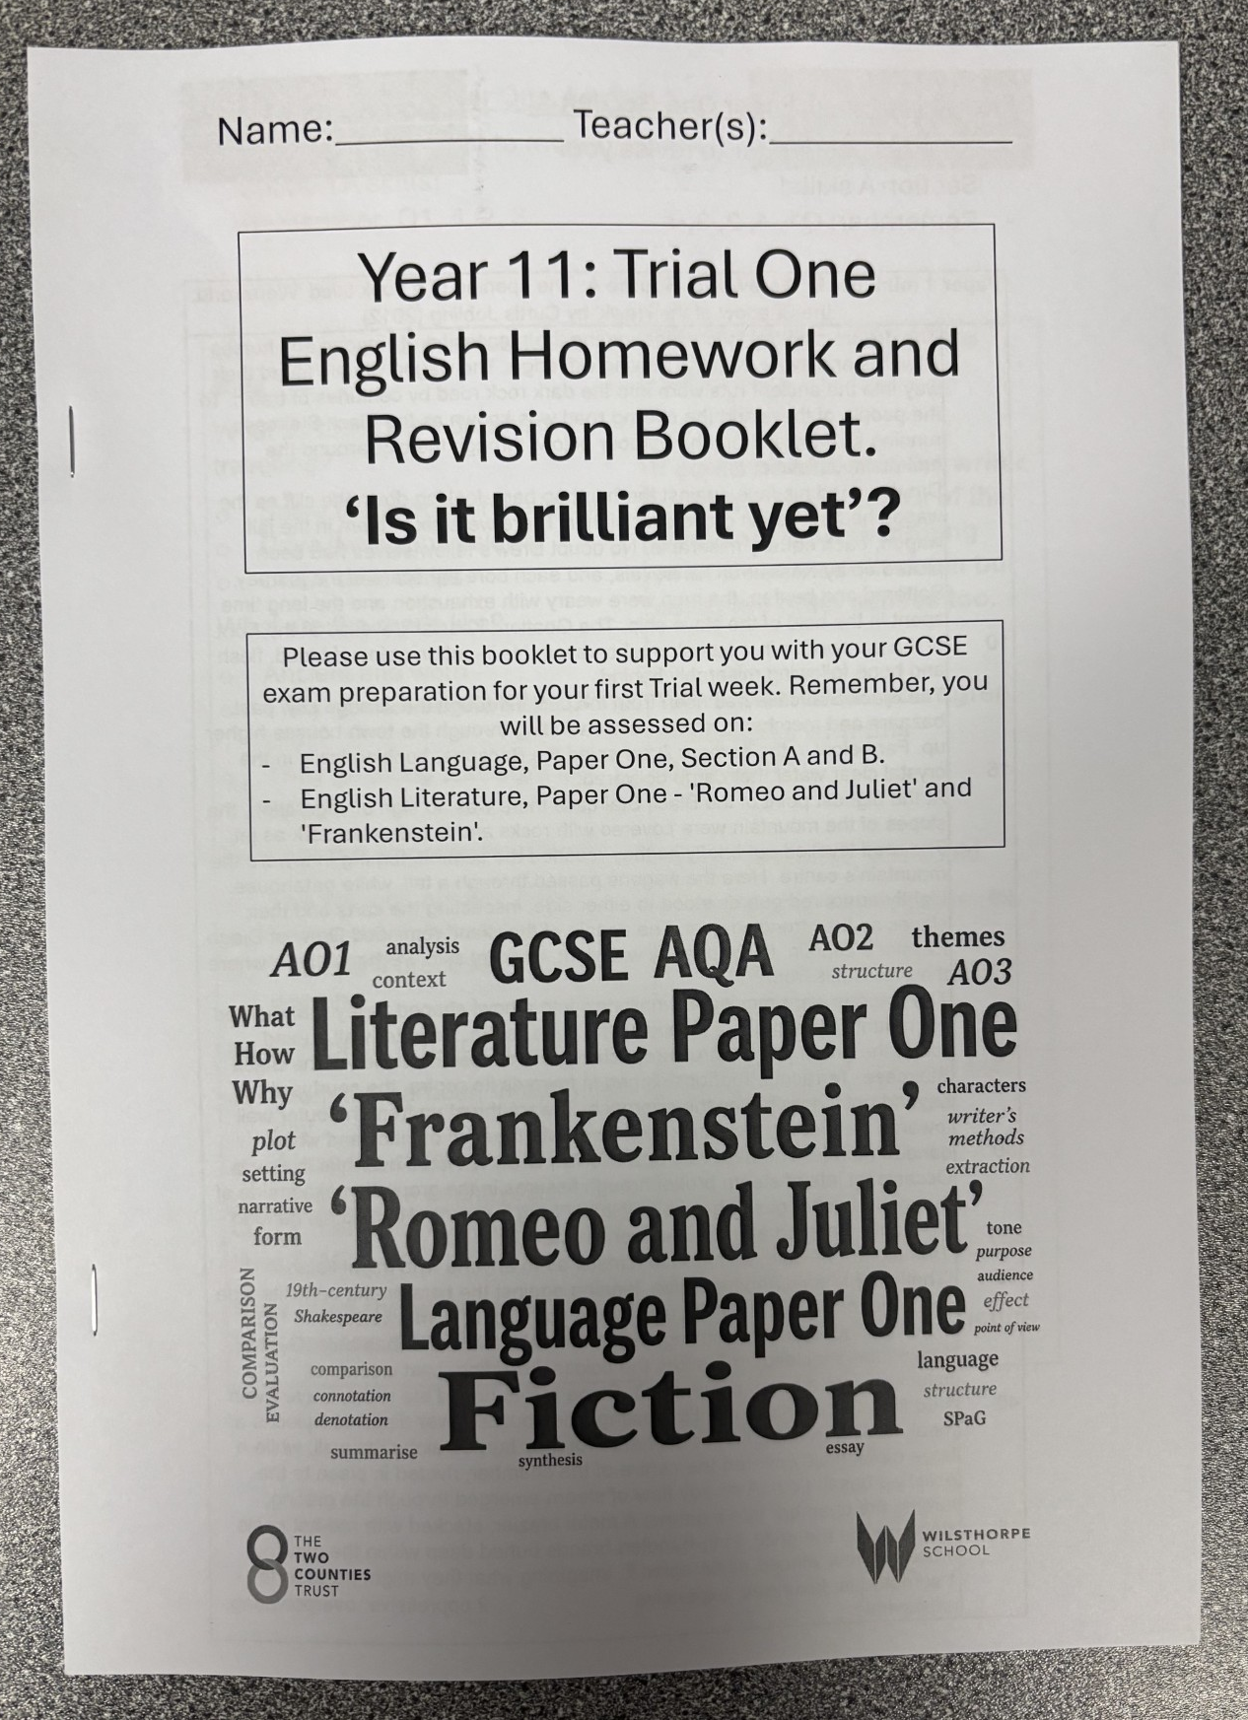
Homework
English Revision: Monday Week A
Students will be given a green exercise book to collate their English homework together.
Students will be given a booklet in the run up to the trials and the actual exams.
We have made revision videos for top tips and our Top 10 quotations – students will get details on how to access these.
Use the 100% booklet, the internet, SENECA and youtube (Mr Bruff) to help revise – students need to ensure they are looking trusted websites.
Keep reading Frankenstein...

Slide 41
Science

Slide 42

All Separate exams are 1hr45 long.
2 papers for each Science (100 marks) each worth 50% of that separate GCSE
Exam board: AQA
Combined Science Trilogy Pathway or Separate Sciences (triple)
Biology Paper 1 1hr15 70 marks (16.7% of GCSE) Cell Biology; Organisation; Infection and response; and Bioenergetics. | Chemistry Paper 1 1hr15 70 marks (16.7% of GCSE) Atomic structure and the periodic table; Bonding, structure, and the properties of matter; Quantitative chemistry; Chemical changes; and Energy changes. | Physics Paper 1 1hr15 70 marks (16.7% of GCSE) Energy; Electricity; Particle model of matter; and Atomic structure.
Biology Paper 2 1hr15 70 marks (16.7% of GCSE) Homeostasis and response; Inheritance, variation and evolution; and Ecology. | Chemistry Paper 2 1hr15 70 marks (16.7% of GCSE) The rate and extent of chemical change; Organic chemistry; Chemical analysis; Chemistry of the atmosphere; and Using resources. | Physics Paper 2 1hr15 70 marks (16.7% of GCSE) Forces; Waves; and Magnetism and electromagnetism

Slide 43
Year 11 Mock Exams
3 papers for mock exams- 1hr15 Combined and 1hr45 for Separates (actual exams in the summer will have 6 papers, 2 per sciences)
Students will be tested on topics they have covered in year 9, 10 and 11.
A revision checklist will be added to their class Microsoft Teams area.
Intervention sessions for revision will run Wednesday week A for Combined Science and for the Triple (separate sciences) there is an additonal revision session Thursday week B afterschool.
Students are expected to revise fully for these so we can prepare for support and interventions.

Slide 44

Revision Support
Key knowledge- from revision guides (CGP) or online (Bitesize)
Sparx Science- For homework and students can also find independent study here
Exam practice- past papers on AQA website and Physics and Maths tutor website.
Seneca- quick knowledge checks
Practicals- video demonstrations on youtube

Slide 45
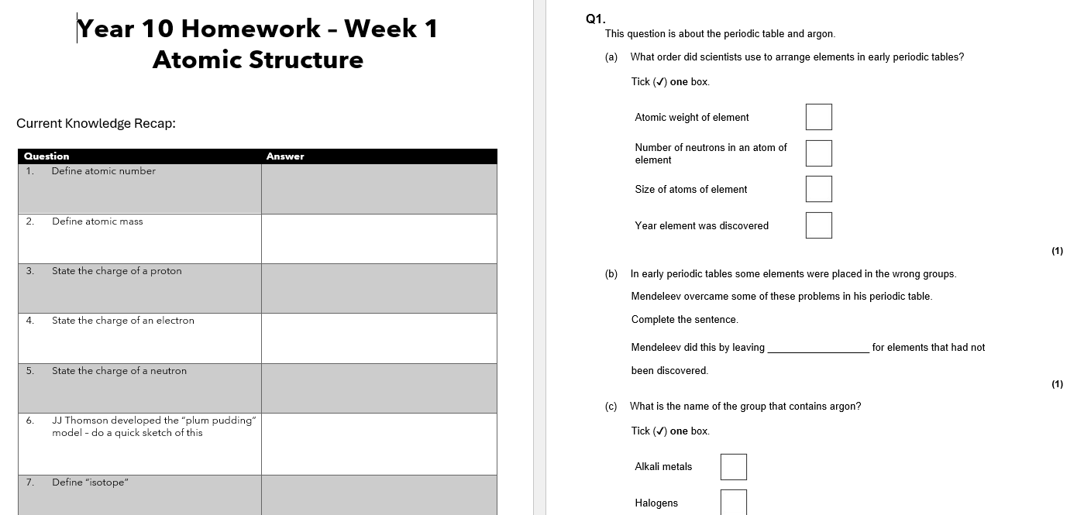
Homework
Weekly 1 hour Sparx homework from Science will be set each Thursday 4pm and submitted the following Thursday by 8am.
Every two weeks students will also be set a paper homework, this will take the form of past paper questions to practise exam technique.

Slide 46
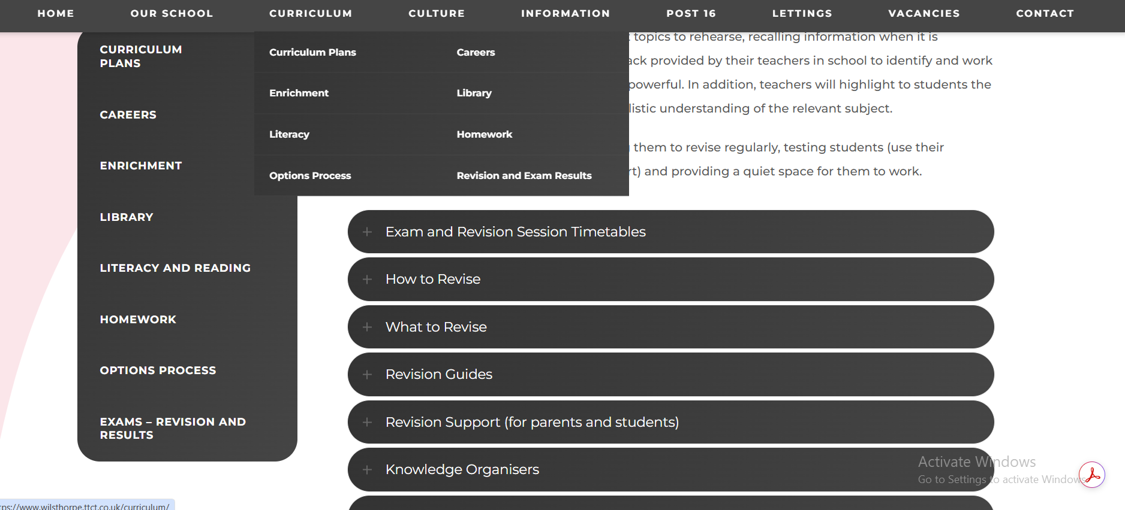


Slide 47
Mental Health & Wellbeing
It is normal to feel stressed and anxious during exams. Managing those feelings, thought and the behaviours that it causes can be difficult. There are lots of charities and groups that provides tips on managing exams stress, as well as more bespoke services that students can contact if they are feeling overwhelmed.
Looking after yourself during exam period | Looking after yourself while preparing for an exam | Looking after yourself on the day of your exam | Looking after yourself after your exam
Make time for things you enjoy Talk to others about how you feel Try to find balance Take care of your physical health Focus on yourself | Find a study group Make a revision timetable Work in the best way for you Revise in the best place for you | Prepare your items the night before Start your day the best you can Try to ground yourself with a breathing exercise Take your time Remind yourself that it'll be over soon | Try not to compare your answers to others Reward yourself Focus on next steps Relax before your next exam

Slide 48



Mental Health & Wellbeing
Hints and tips on managing exam stress
https://www.mind.org.uk/for-young-people/feelings-and-experiences/exam-stress/
Help for parents and students about support with mental health and exam stress
https://www.youngminds.org.uk/parent/blog/how-to-help-your-child-manage-exam-stress/
Students can chat online about their worries, as well access articles and discussions
https://www.kooth.com/

Slide 49

Mental Health & Wellbeing

Slide 50
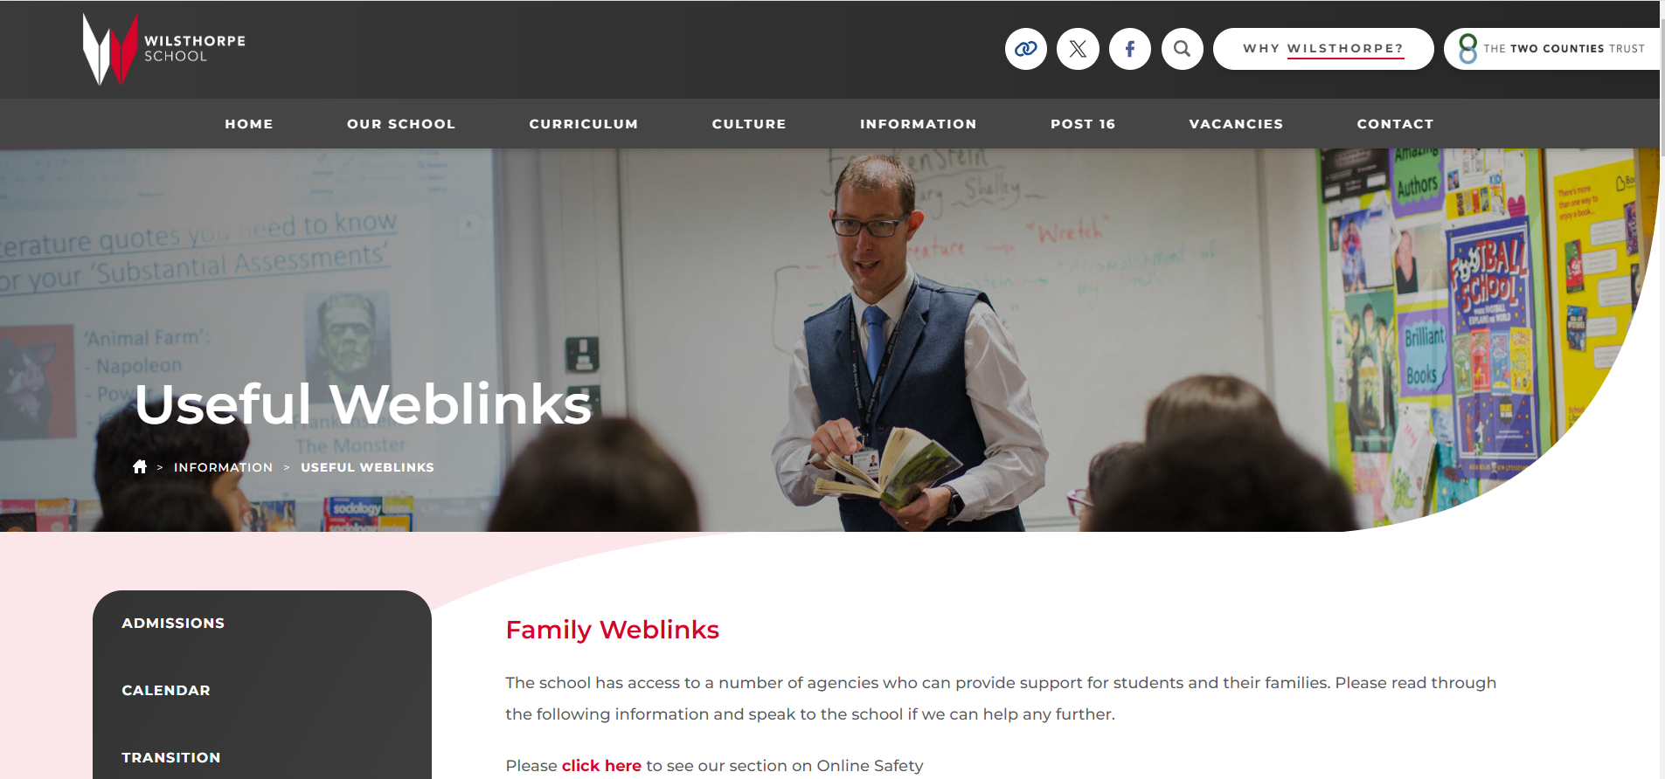
Mental Health & Wellbeing
https://www.wilsthorpe.ttct.co.uk/information/useful-weblinks/#1623761629243-70b2bc50-86fd

Slide 51
Exam Expectations
Uniform
You must be in the full, correct uniform for each exam, this includes jewellery.
Mobile Phones
Phones should be in pouches and turned off
You must not be wearing any type of watch.
You can be disqualified from an exam if you are found with a phone/watch on you.
Equipment
You must bring the following items to your exams:
Clear plastic pencil case
2 black pens
Pencil and sharpener
Ruler
Maths set
Calculator (the lid must be removed and put in your bag before you go in to the exam room)
Clear water bottle (any labels must be removed before entering the exam room)
Going in to the Exam
You must be silent from the moment you go in to the exam room.
In the Exam
You must not take any revision materials in to the exam room with you, for example, notes, flash cards etc.
Just having these on you (even by mistake) can disqualify you from the exam.
Please check your pockets before you go over to the exam room and put any materials in your bag.
You must also ensure you have no writing on your hands/arms.
Toilet Breaks
Please ensure you go to the toilet before the exams start.
Unless you have a toilet pass, you will not ordinarily be allowed to go to the toilet during the exam as this causes a great deal of disruption to everyone else in the exam room.

Slide 52
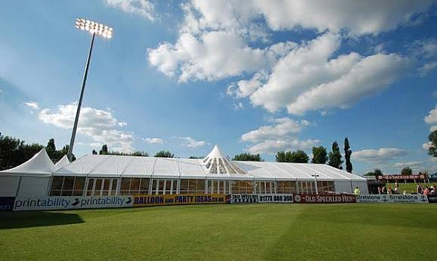
Prom Launch 2027
Everyone in Year 11 is invited to Prom
“Privilege not a right”
Strict rules around behaviour and attendance which may result in the removal of their invitation.
Derbyshire County Cricket Club
Friday 25th June 2027 (TBC due to fixtures)

Slide 53
Year 11 Calendar
Monday 14th September 2026 | Year 11 Launch Event | Wednesday 3rd February 2027 – Friday 12th February 2027 | Year 11 Trial Exams 2
W/C Monday 21st September 2026 | Year 11 Music Performances | Friday 12th February 2027 – Monday 15th February 2027 | Iceland Trip
Thursday 1st October 2026 | Sixth Form Open Evening | W/C Monday 8th March 2027 | Data Collection & Trackers
Thursday 8th October 2026 | Year 11 Drama Performances | Tuesday 22nd March 2027 | Year 11 Intervention Evening
Wednesday 14th October 2026 | Year 11 TTCT Careers Fair | Wednesday 14th April 2027 | Year 11 Drama Performance Day
Thursday 15th October 2026 – Friday 23rd October 2026 | Year 11 Trial Exams 1 | Monday 10th May 2027 – Friday 18th June 2027 | GCSE Exams
W/C Monday 16th November 2026 | Data Collection and Tracker 1 | TBC | Year 11 Leavers Day
Tuesday 24th November 2026 | Year 11 Parents’ Evening | Friday 25th June 2027 (TBC) | Prom

